Slide 1

Design and Implementation of a Privacy-Preserving String-Matching Framework Using Searchable Encryption and Trusted Execution Environments(TEE)
CSA5116-Cryptography And Network Security
Guided By
Dr E Anbalagan
Presented By
Atchaya Chandran R-192521394
Surabhi Surya P S-192421267
Vikram-192411166
Susidharan V-192521387

Slide 2
Abstract
Problem: Enables secure string matching on sensitive data without exposing plaintext, addressing privacy risks in traditional pattern-matching methods.
Real-life problem: Organizations like hospitals and cloud service providers need to search or match sensitive text data (e.g., patient records, financial documents) stored on untrusted third-party servers, but exposing this data in plaintext — even to the server performing the search — risks data breaches, regulatory violations (HIPAA/GDPR), and loss of user trust.
Approach: Combines Searchable Encryption (query on ciphertext) with Trusted Execution Environments (isolated, tamper-resistant computation) for a hybrid security model.
Result: Achieves efficient exact/approximate matching with reduced information leakage and lower overhead — ideal for genomic search, document retrieval, and encrypted cloud analytics.

Slide 3
Introduction
Privacy-Preserving String Matching: Enables secure string matching on encrypted data without revealing sensitive information to unauthorized users.
Searchable Encryption (SE): Allows users to search encrypted data efficiently without decrypting it, ensuring confidentiality and secure access.
Trusted Execution Environments (TEEs): Provides a secure hardware-protected environment to perform sensitive computations while preventing data leakage.
Secure and Efficient Framework: Integrates Searchable Encryption with TEEs to achieve fast, accurate, and privacy-preserving string matching in cloud environments.
Real-World Applications: Improves data security and privacy in cloud storage, healthcare, finance, and other applications requiring secure information retrieval.

Slide 4
Objectives
To develop a privacy-preserving framework for secure string matching on encrypted data.
To implement Searchable Encryption (SE) for efficient searching without decrypting sensitive information.
To utilize Trusted Execution Environments (TEEs) for secure and protected execution of search operations.
To improve the accuracy, efficiency, and confidentiality of encrypted string matching in cloud environments.
To ensure secure data retrieval while protecting user privacy and preventing unauthorized data access.

Slide 5
Problem Statement
Sensitive data stored in cloud environments is vulnerable to unauthorized access during search and processing.
Traditional string matching methods require data to be decrypted, increasing the risk of privacy breaches.
Existing searchable encryption techniques may suffer from performance overhead and information leakage.
Lack of secure execution environments makes encrypted search operations vulnerable to attacks.
A secure and efficient framework is needed to enable privacy-preserving string matching while maintaining high search accuracy and data confidentiality.

Slide 6
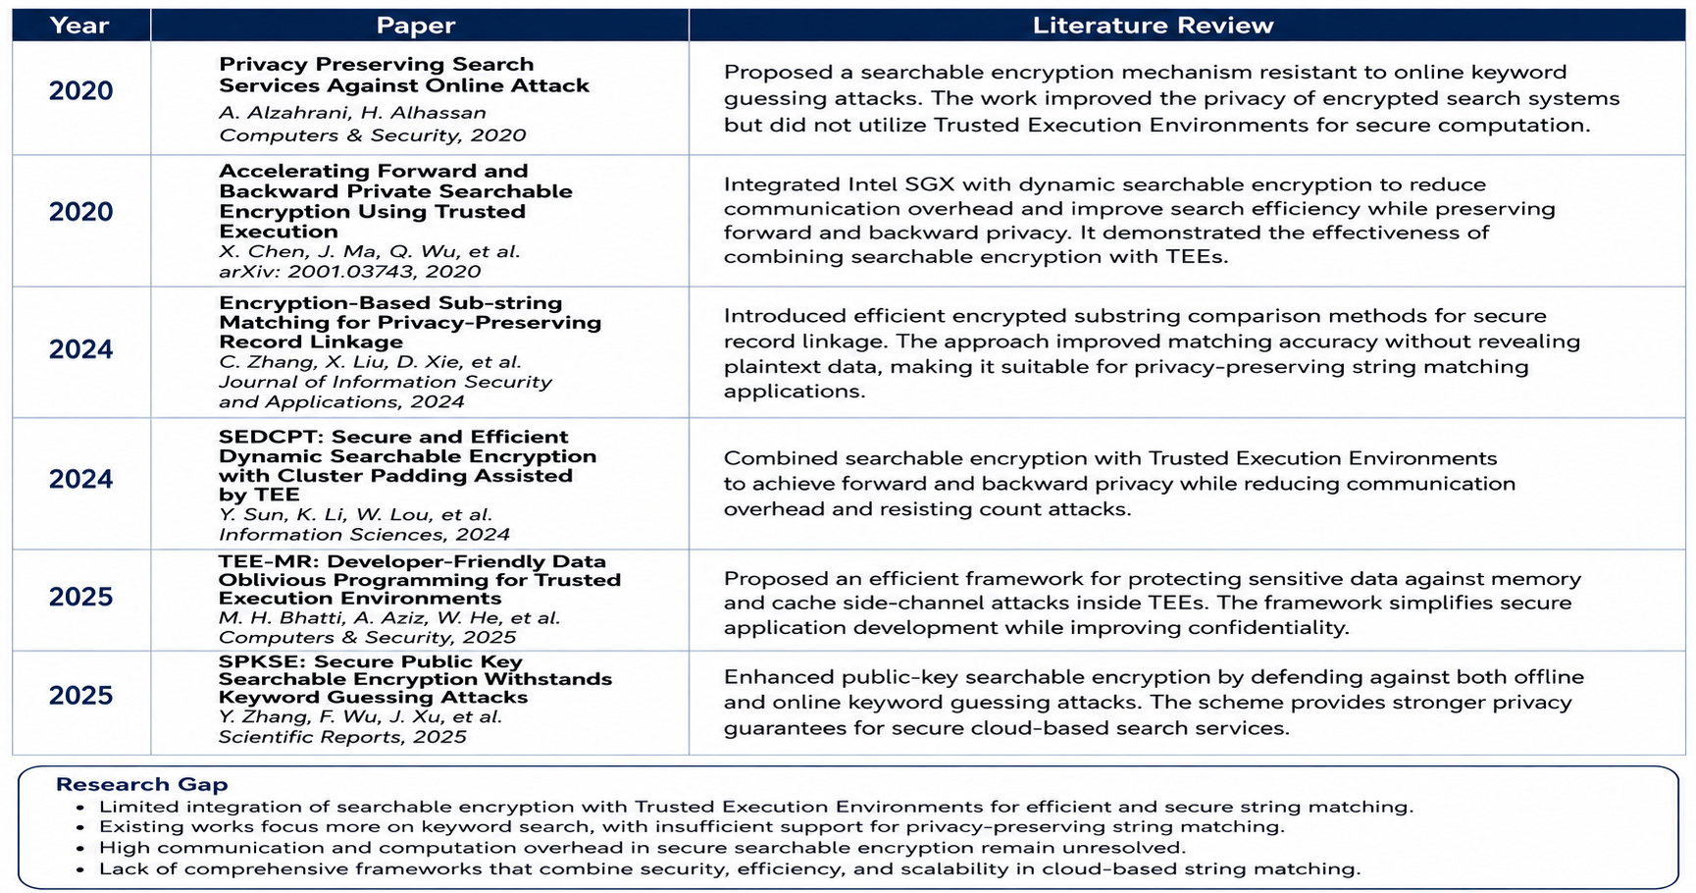
Literature Review

Slide 7
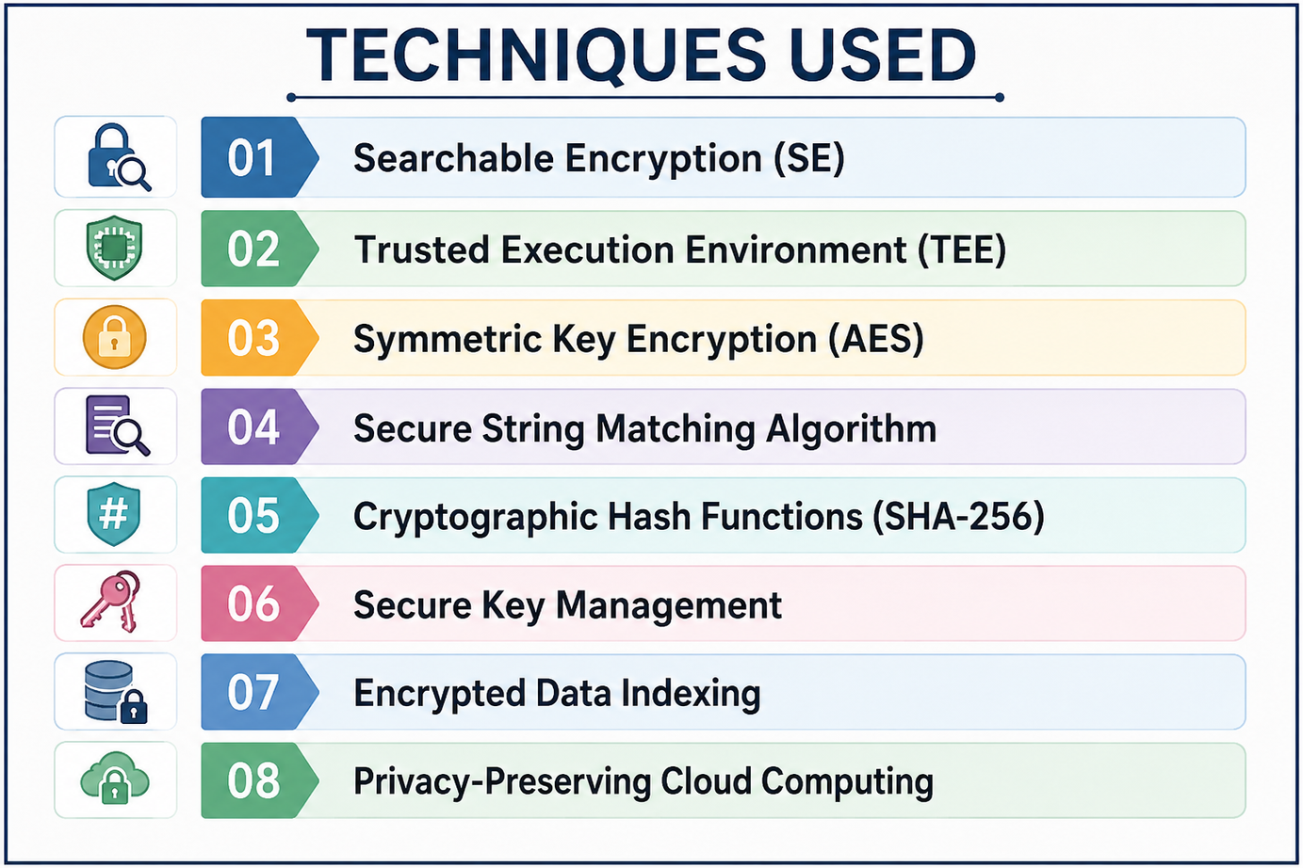
Techniques Used
Searchable Encryption (SE)
Trusted Execution Environment (TEE)
Symmetric Key Encryption (AES)
Secure String Matching Algorithm
Cryptographic Hash Functions (SHA-256)
Secure Key Management
Encrypted Data Indexing
Privacy-Preserving Cloud Computing

Slide 8
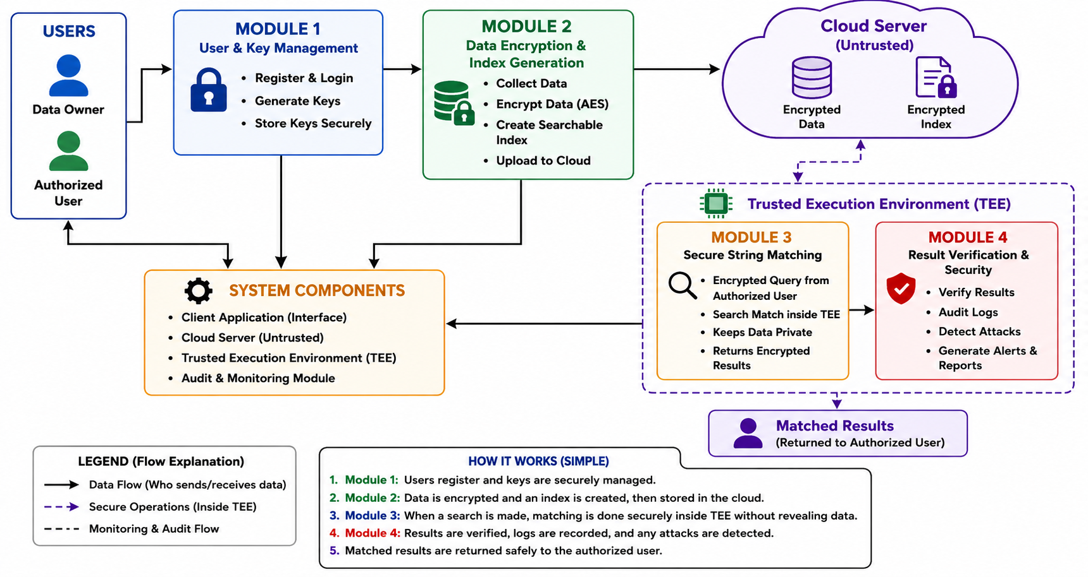
Block Diagram

Slide 9
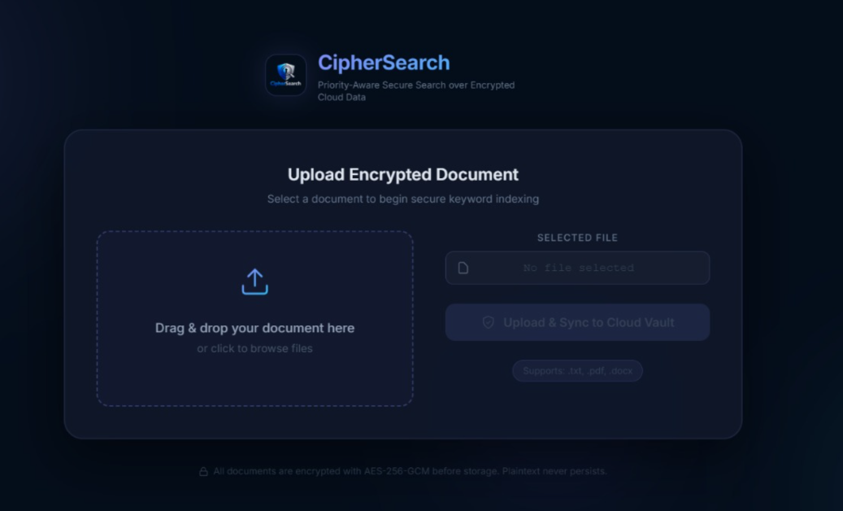
Module 1-Secure User Authentication & Cryptographic Key Management
User Registration and Secure Authentication – Verifies user identity before granting access to the system.
Cryptographic Key Generation – Generates secure encryption keys (AES/RSA) to protect sensitive data.
Secure Key Storage and Management – Safely stores and manages cryptographic keys to prevent unauthorized access.
Access Control and Authorization – Ensures that only authenticated and authorized users can perform secure operations.
Data and Key Protection – Maintains the confidentiality and integrity of user data and encryption keys throughout the system.

Slide 10
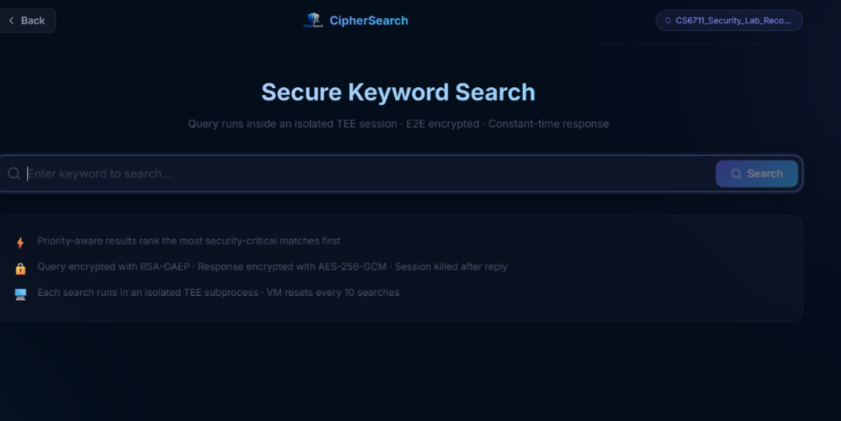
Module 2-Secure Data Encryption & Searchable Index Generation
Data Encryption – Encrypts sensitive data using strong encryption algorithms before storing it in the cloud.
Searchable Index Generation – Creates a secure searchable index that enables efficient searches over encrypted data.
Secure Data Storage – Stores encrypted data and indexes securely without exposing the original information.
Privacy-Preserving Search Support – Allows authorized users to perform searches without decrypting the stored data.
Efficient Data Retrieval – Ensures fast, accurate, and secure retrieval of matching encrypted records.

Slide 11
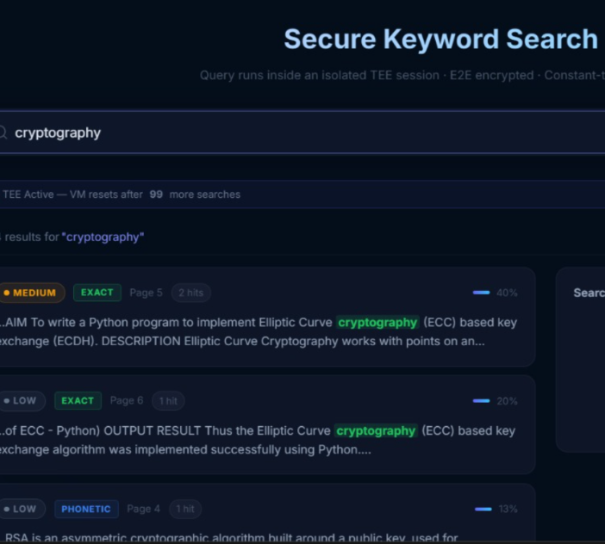
Module 3-Privacy-Preserving Secure String-Matching Engine
Secure String Matching – Performs string matching on encrypted data without revealing the original content.
Trusted Execution Environment (TEE) – Executes matching operations inside a secure hardware-protected environment.
Privacy-Preserving Search – Ensures that sensitive data remains confidential throughout the search process.
Accurate Matching Results – Identifies matching strings efficiently while maintaining high search accuracy.
Secure Processing – Protects search operations from unauthorized access and information leakage.

Slide 12
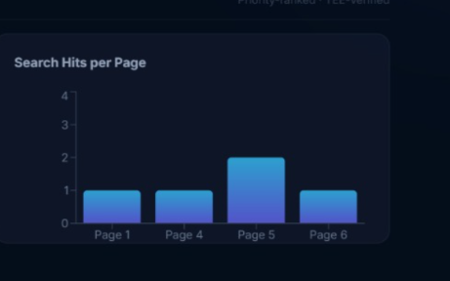
Module 4-Secure Result Verification, Auditing & Attack Detection
Secure Result Verification – Verifies the correctness and integrity of search results before they are returned to the user.
Audit Log Generation – Records user activities and search operations for transparency and accountability.
Attack Detection – Monitors the system to identify unauthorized access, suspicious behaviour, and potential security threats.
Integrity and Privacy Protection – Ensures that data remains secure and unaltered during retrieval and verification.
Security Monitoring and Reporting – Generates alerts and security reports to support continuous system monitoring and threat response.

Slide 13
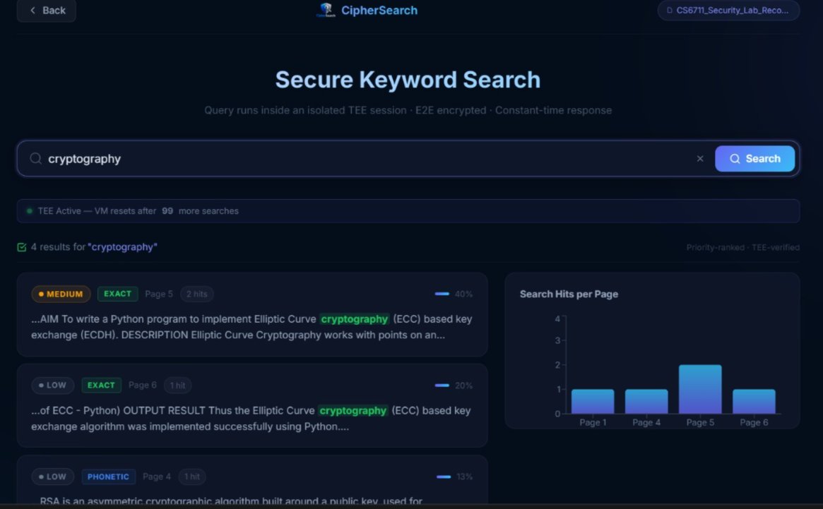
Implementation

Slide 14
Result
Successfully performs accurate string matching on encrypted data without exposing sensitive information.
Protects confidential data using Searchable Encryption and Trusted Execution Environments (TEEs).
Provides fast and accurate search results while maintaining data privacy and confidentiality.
Prevents unauthorized access through secure authentication, encryption, and attack detection mechanisms.
Ensures secure, accurate, and trustworthy retrieval of encrypted information with result verification.

Slide 15
Conclusion
The proposed framework enables secure and privacy-preserving string matching on encrypted data.
Searchable Encryption and Trusted Execution Environments ensure strong data confidentiality and secure processing.
The system provides efficient and accurate search results without revealing sensitive information.
Secure authentication, encryption, and attack detection improve the overall reliability of the framework.
The framework is suitable for cloud storage, healthcare, finance, and other applications requiring secure data retrieval.

Slide 16
References
National Institute of Standards and Technology (NIST), Searchable Encryption and Cryptographic Standards, NIST Publications, 2024.
International Organization for Standardization (ISO), ISO/IEC 27001:2022 – Information Security, Cybersecurity and Privacy Protection, ISO, 2022.
Intel Corporation, Intel® Software Guard Extensions (Intel SGX) Developer Guide, Intel, 2024.
Cloud Security Alliance (CSA), Security Guidance for Critical Areas of Focus in Cloud Computing v5.0, Cloud Security Alliance, 2024.
Microsoft Corporation, Microsoft Azure Confidential Computing Documentation, Microsoft, 2024.
Google Cloud, Confidential Computing and Data Protection Documentation, Google LLC, 2024.
Amazon Web Services, AWS Encryption SDK and Security Best Practices, Amazon Web Services, 2024.
IEEE Xplore Digital Library, Research Articles on Searchable Encryption, Trusted Execution Environments (TEEs), and Privacy-Preserving Data Search, https://ieeexplore.ieee.org/
ACM Digital Library, Research Papers on Secure String Matching and Searchable Encryption, https://dl.acm.org/
National Institute of Standards and Technology (NIST), Cybersecurity Framework (CSF) 2.0, NIST, 2024.

Slide 17


